Slide 1

AnecJokes

Slide 2

An introduction
My name is….

Slide 3




The Problem

Slide 4

Example

Slide 5
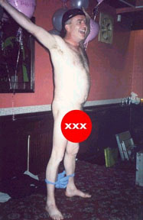
Example

Slide 6

How I tackled it

Slide 7

Demonstration Time

Slide 8
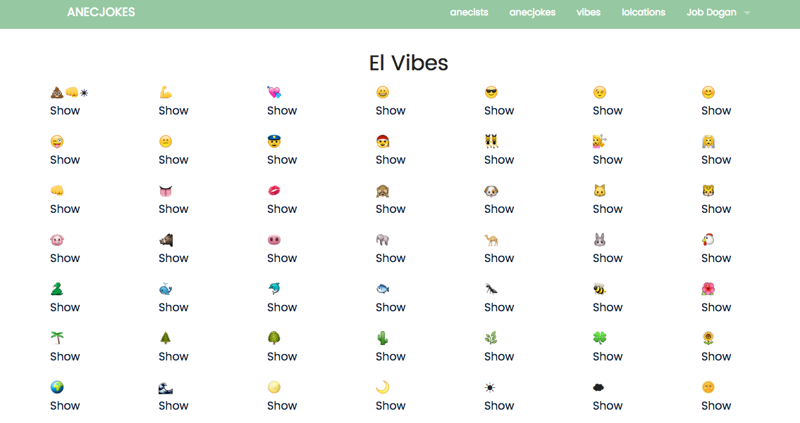
Fun Features

Slide 9
More Fun
…with the pun

Slide 10
Importance
Memories of all kinds
Beyond the laughter
Granny
The historian

Slide 11
Features for the Future
Big plans

